Slide 1
freeDiving by dels
Computer Lab 2

Slide 2
Functionalities
Several training types
Detailed training history for all types
Customized training
Webshop with product and transaction details (also ability to add own)
User control

Slide 3
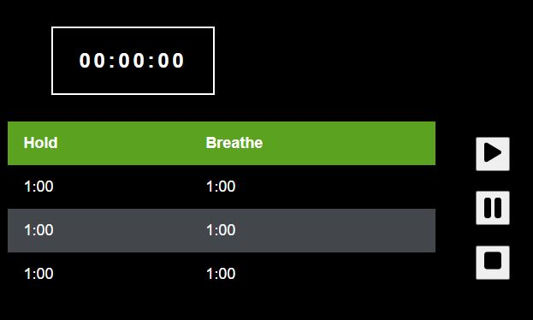
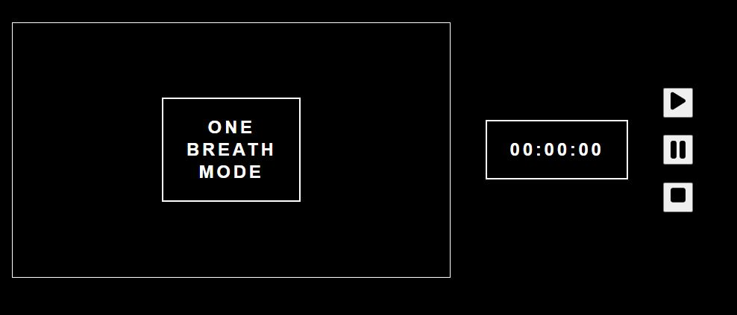
Training types

Slide 4
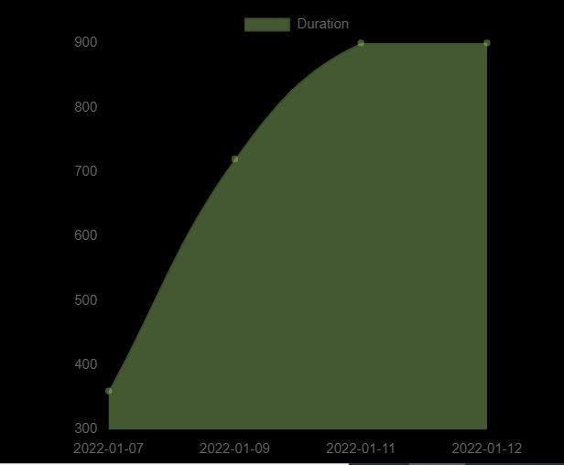
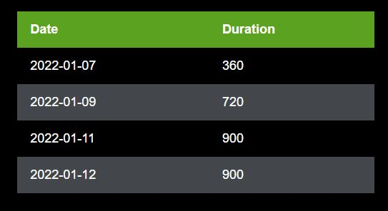
Training history

Slide 5
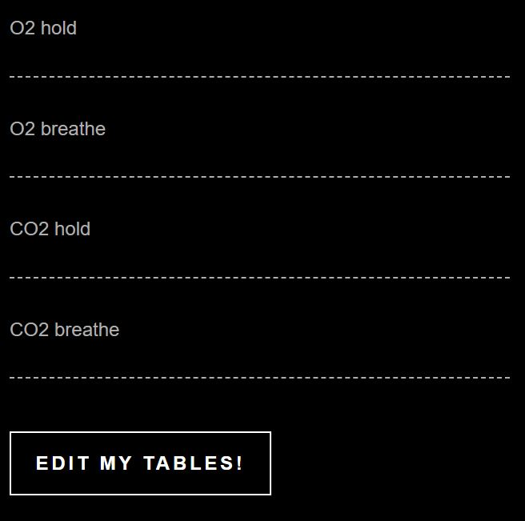
Training customization

Slide 6
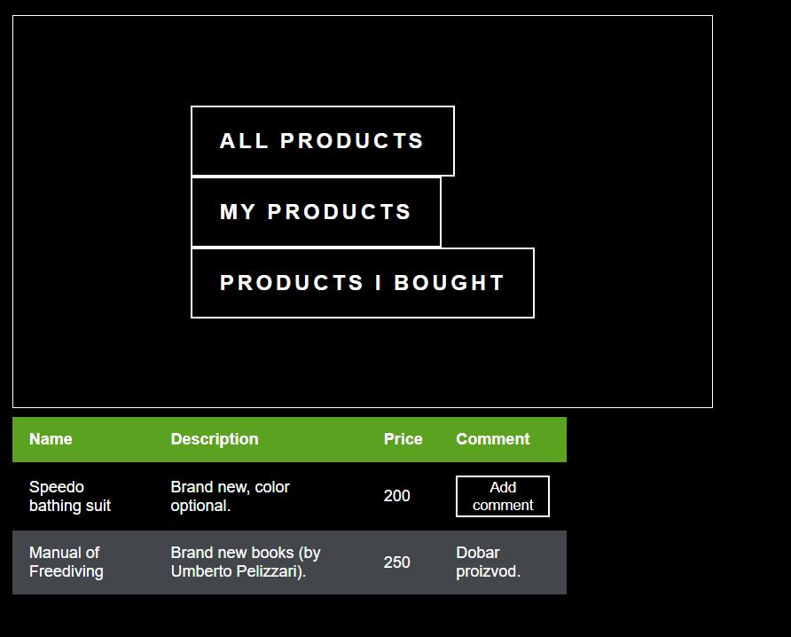
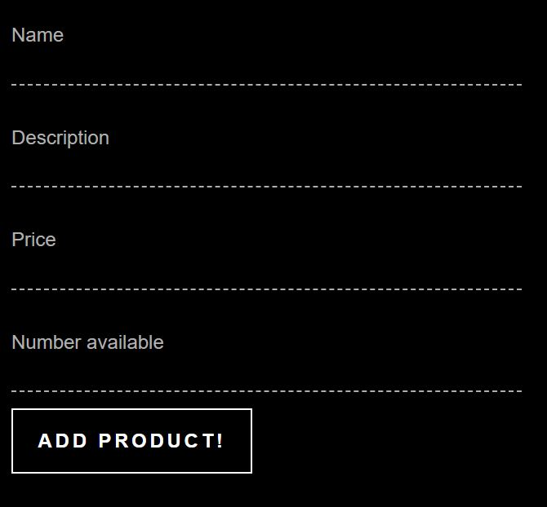
Webshop

Slide 7
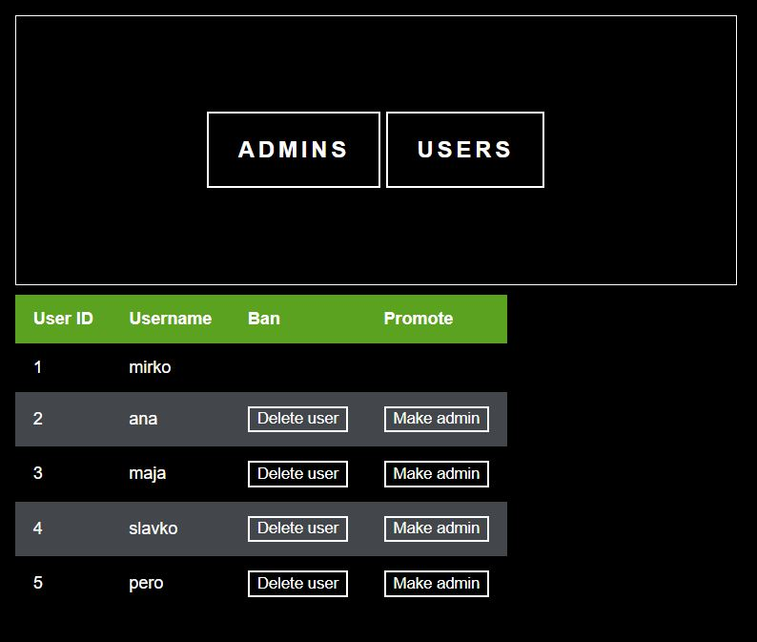
User control

Slide 8
Props and future prospects
Props:
Available on small screens
Fast
Aesthetically and auditory pleasing (important for serenity!)
Future prospects:
More types of training
Scaling in graphic view
Different sound control and options
Variety of shop functions

